Slide 1
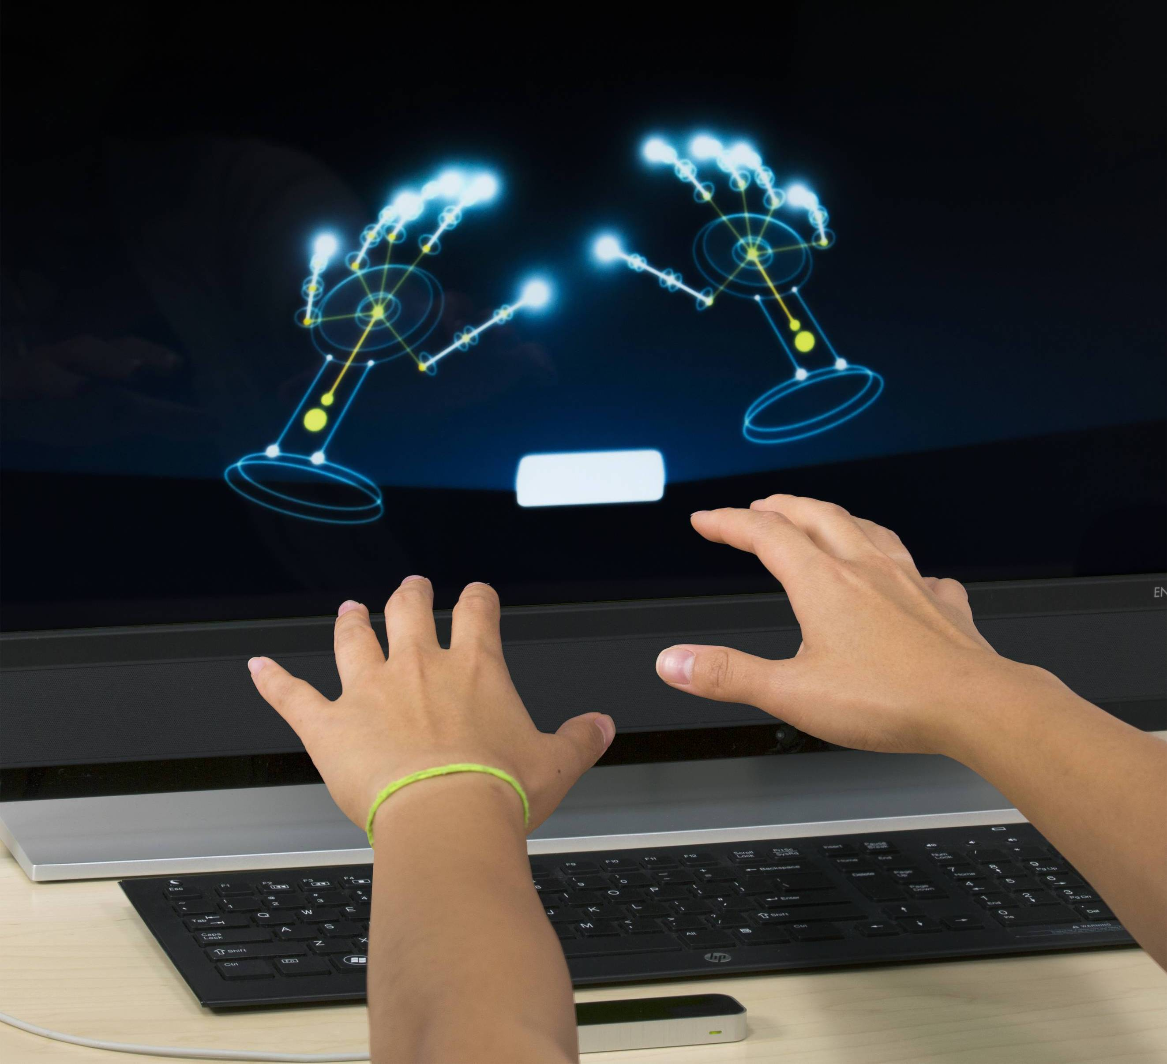
Leap Motion

Slide 2
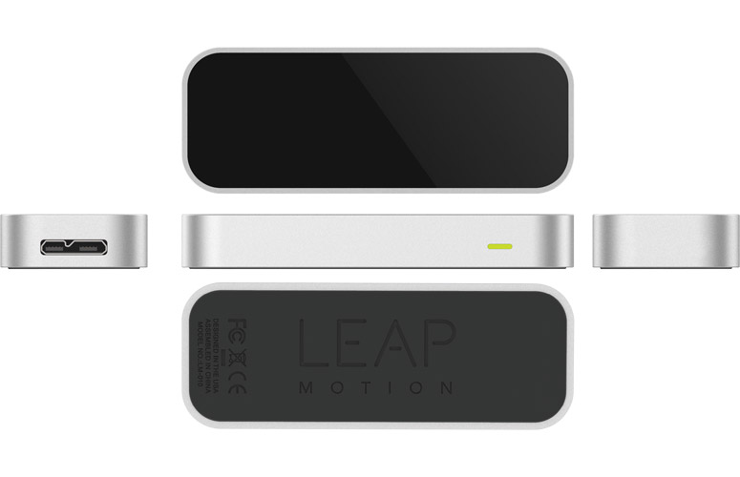
What is Leap Motion?
Leap Motion is a small USB peripheral that creates a 3D interaction space to precisely interact with and control software on your computer.

Slide 3
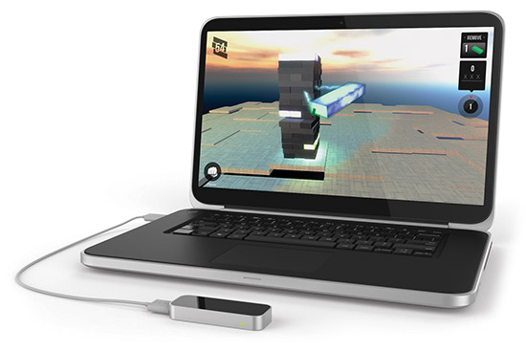
Installing Leap Motion on your computer
Installing Leap Motion is as simple as plugging in a Thumb Drive.
Simply insert the cable from the Leap Motion into a USB port on your computer and allow the drivers to automatically install.
This could take up to 5 minutes.

Slide 4
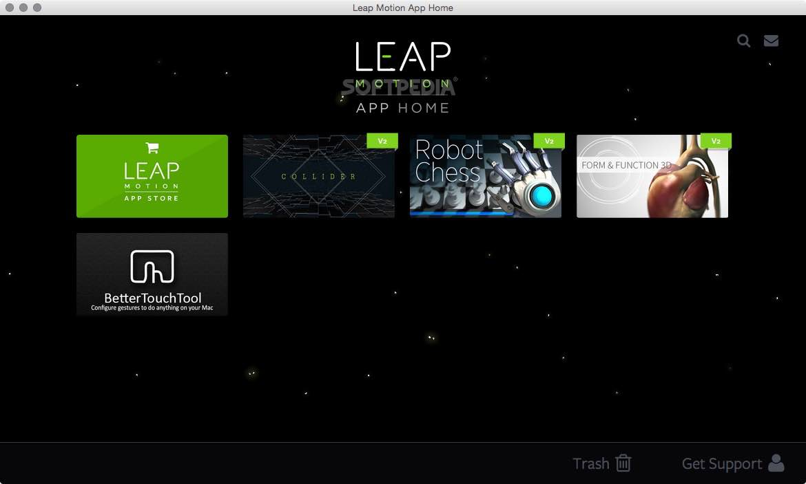
The Leap Motion App Home

Slide 5
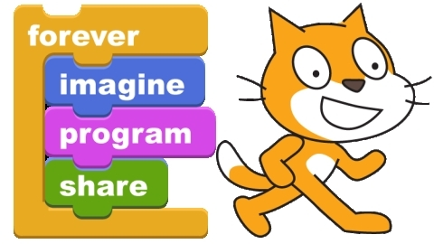
Scratch

Slide 6
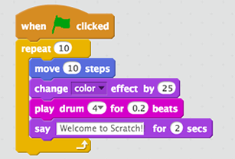
What is Scratch?
Scratch is a drag and drop programming language designed to teach concepts without the need to worry about syntax.

Slide 7
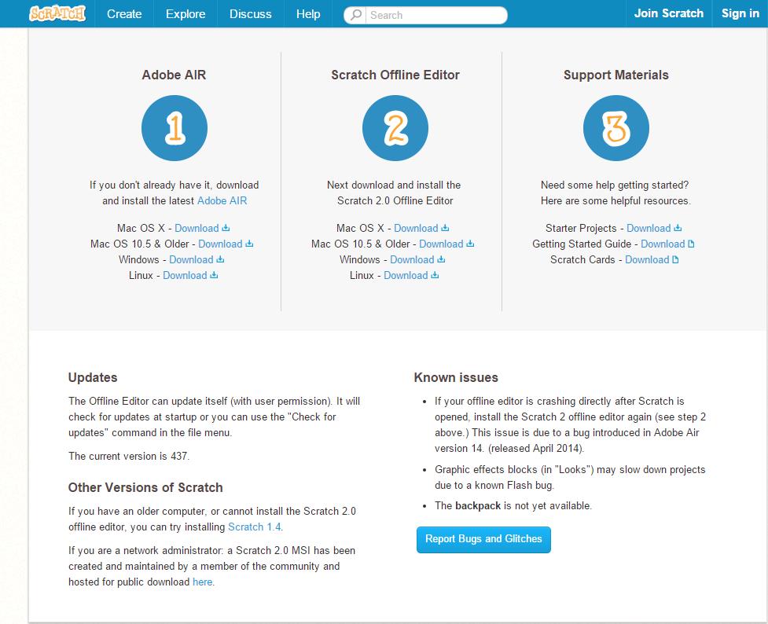
Installing Scratch Offline Editor
To install the Scratch offline editor go to https://scratch.mit.edu/scratch2download/
Or alternatively do a google search for Scratch offline editor and click the first link on the results page.
The Page you should be on should look like this

Slide 8


Installing Scratch Offline Editor Cont…
Find this installation link that matches your computer and click it.
The installation file should start to download.
Once it is complete run the setup.
Be sure to click the option to add a shortcut to your desktop.
Congratulations!!! Scratch is now on your computer.

Slide 9
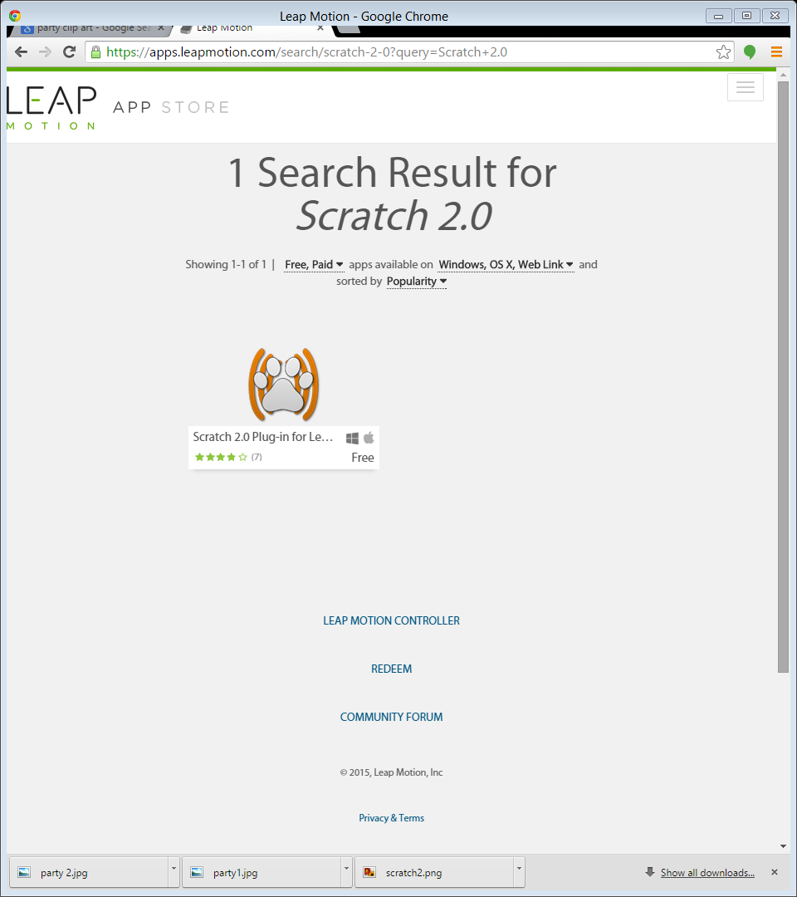
Connecting both Scratch and Leap motion
Open the Leap Motion app home.
Click on the Leap Motion App Store button to be taken to the
App Store
Once at the app store click the magnifying glass at the top right
hand corner of the screen to open the search manure
and search for Scratch 2.0.
Click on the icon shown and then the download button.

Slide 10
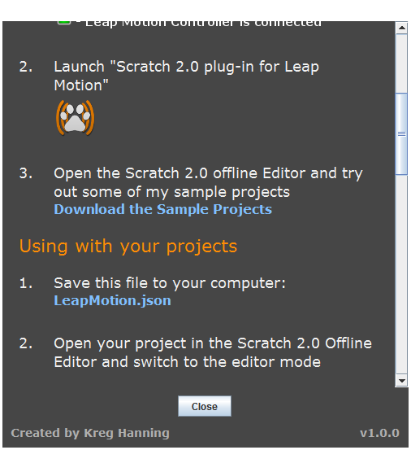
Connecting both Scratch and Leap Motion Cont…
Open back up the Leap Motion App Home.
Click on the Scratch 2.0 plugin.
Then click the question Mark at the lower right hand corner.
Scroll down to the using with your projections section.
Click the blue LeapMotion.json download and save the download to a convenient place on your computer

Slide 11
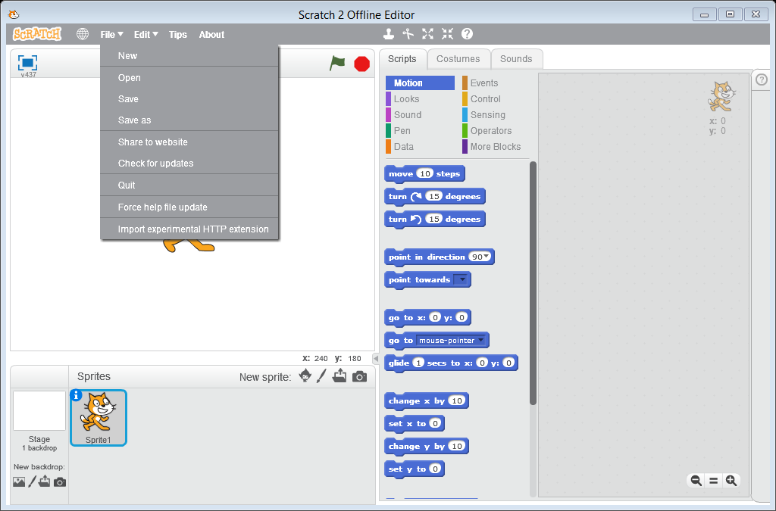
Connecting both Scratch and Leap Motion Cont…
Connect your leap motion if not already connected.
Open your Scratch Offline Editor.
Holding down the shift button on your keyboard left click on the file tab.
Click the very bottom option Import experimental HTTP extension
Open your LeapMotion.json file
Congratulations you should now have Leap Motion blocks under the more blocks tab.

